Slide 1
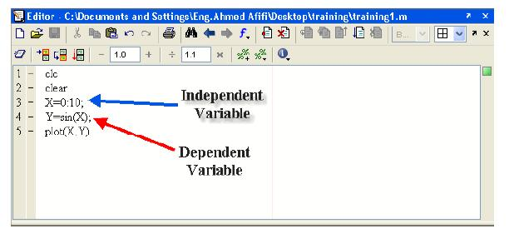
Lecture 3:
Basic graphics
The PLOT command we produced this command in plot sine function.
Independent :مستقل : dependent : تابع

Slide 2
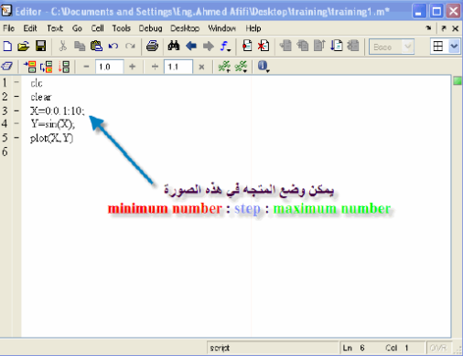
To increase the points we put

Slide 3
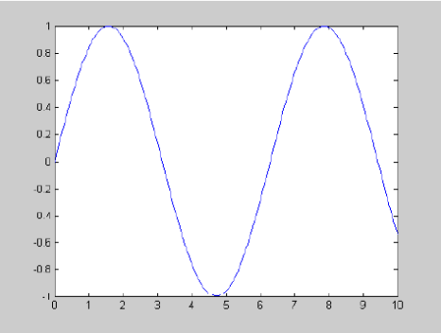

Slide 4
Try with following example:
Ex:
x=0:0.1:2*pi;
Y=sin(x);
Plot(x,y)
There are many options for changing the appearance of a plot .for example plot(x,y,'-.') will join the points using a red dash-dotted line
Other colours you can use are : 'c' , 'm','y','r', 'g' ,'b','w','k' which correspond to cyan , magenta,yellow,red,green,blue,white, and black. Possible line styles are : solid '-', dashed' - -',dotted ':' ,and dash-dotted '-.' .to plot the points themselves with symbols you can use : dots '.' , circles 'o' , plus signs '+' , cross 'x' , or stars '*' , and many others (type help plot for a list ).

Slide 5
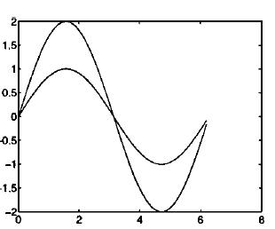
Plot(x, y, 'bx' ) plots the points using blue crosses without joining them with lines ,and plot(x ,y, 'b:x') plots the points using blue crosses and joins them with a blue dotted line . colours , symbols and lines can be combined , for example , 'r.-' , 'rx-' or 'rx:'
Plotting many lines
To plot more than one line you can specify more than one set of x and y vectors in the plot command :
Plot (x,y,x,2*)

Slide 6
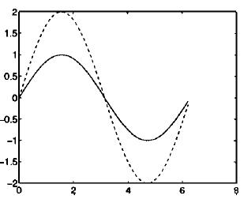
On the screen matlab distinguishes the lines by drawing them in different colors. If you need to print in black
and white , you can differentiate the lines by plotting one of them with a dashed line.

Slide 7
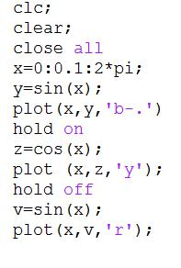
Adding plot
When you issue a plot command matlab clears the axes and produces a new plot .
to add to an existing plot, type hold on for Example.
To switch off the hold behavior , type hold off .

